Slide 1
Software Structure
By Pargol Poshtareh
Lecture 2

Slide 2
Outline
What is Node.js
What Can Node.js Do?
What is a Node.js File?
Getting start with Node.js

Slide 3
What is Node.js?
Node.js is an open source server environment
Node.js is free
Node.js runs on various platforms (Windows, Linux, Unix, Mac OS X, etc.)
Node.js uses JavaScript on the server
What Can Node.js Do?
Node.js can generate dynamic page content
Node.js can create, open, read, write, delete, and close files on the server
Node.js can collect form data
Node.js can add, delete, modify data in your database

Slide 4
What is a Node.js File?
Node.js files contain tasks that will be executed on certain events
A typical event is someone trying to access a port on the server
Node.js files must be initiated on the server before having any effect
Node.js files have extension ".js"
Node.js is a runtime environment. It is not a framework

Slide 5
Download Node.js
The official Node.js website has installation instructions for Node.js:
https://nodejs.org
But first check if you have Node by default
Command : node -v

Slide 6
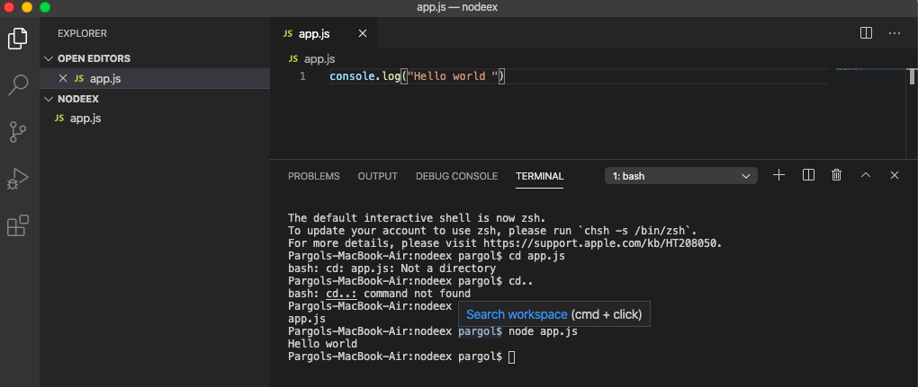
Getting Started
Open Visual studio and terminal.
Create folder and file
How to run in terminal?

Slide 7
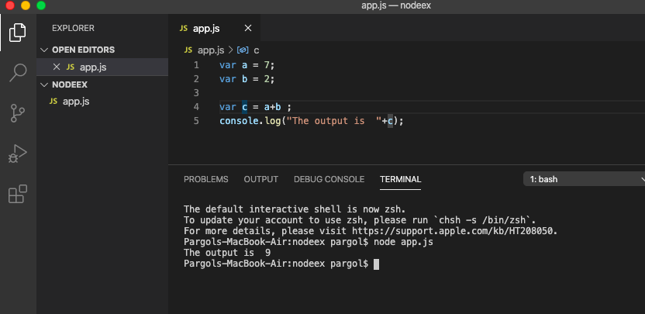
How var works ?

Slide 8
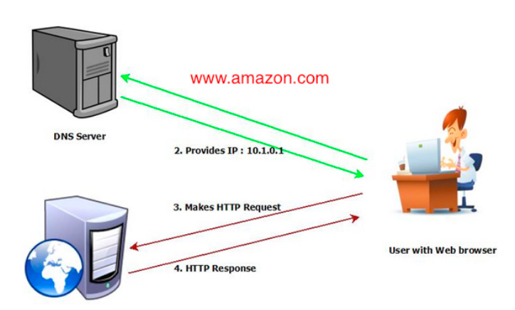
How domain Name works?

Slide 9
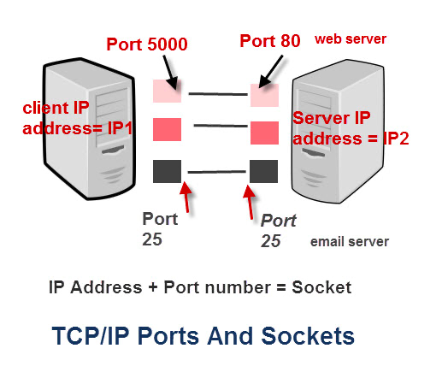
Each IP Address has multiple services :
HTTP : 80
FTP : 21
SMTP : 25

Slide 10
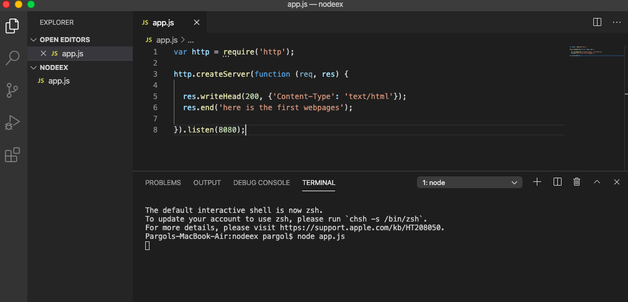
Create Server :

Slide 11
NPM (Node Package Management)
NPM is a package manager for Node.js packages, or modules if you like.
www.npmjs.com hosts thousands of free packages to download and use.
The NPM program is installed on your computer when you install Node.js
What is a Package?
A package in Node.js contains all the files you need for a module.
Modules are JavaScript libraries you can include in your project.

Slide 12
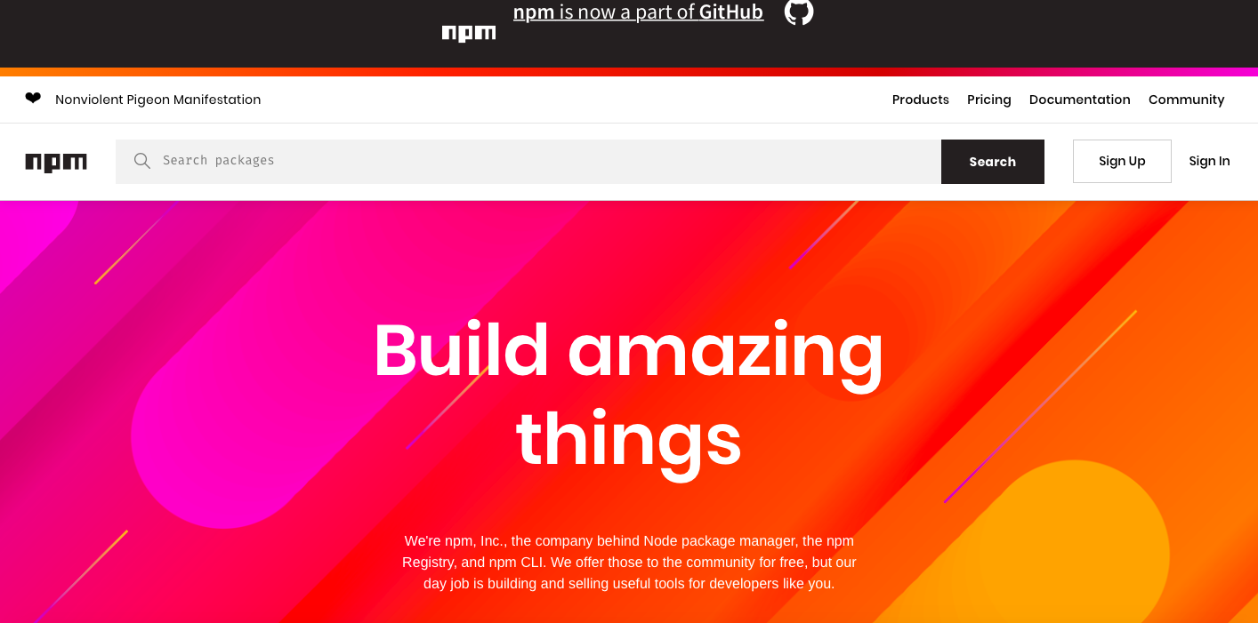
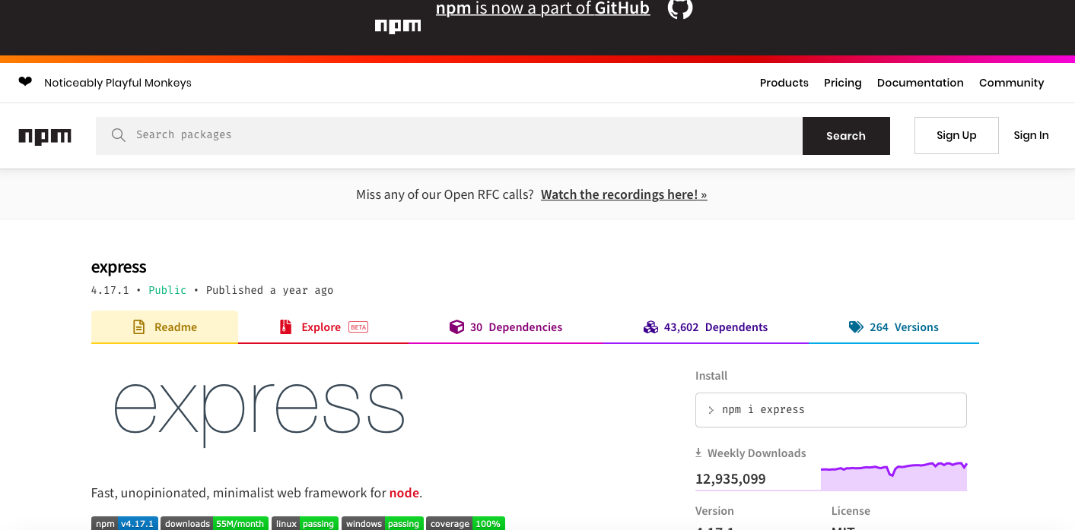
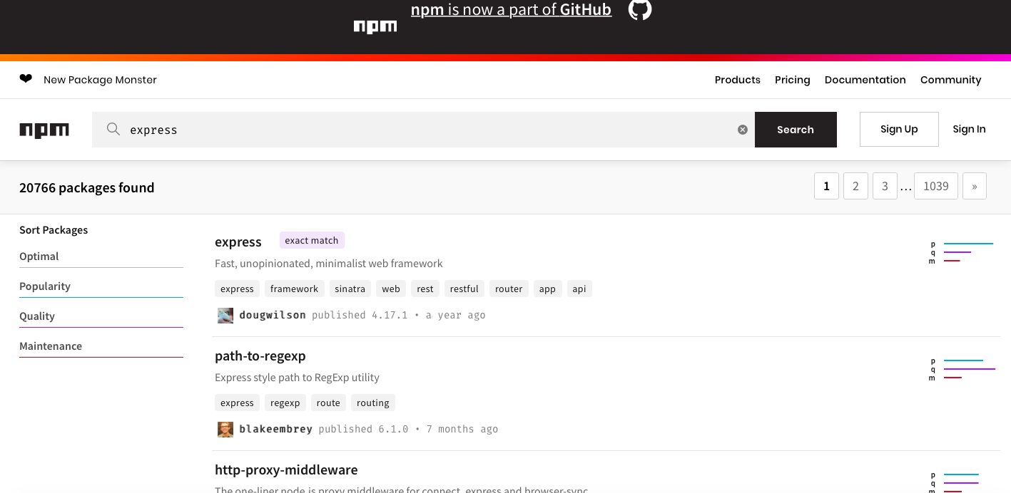
Install npm

Slide 13
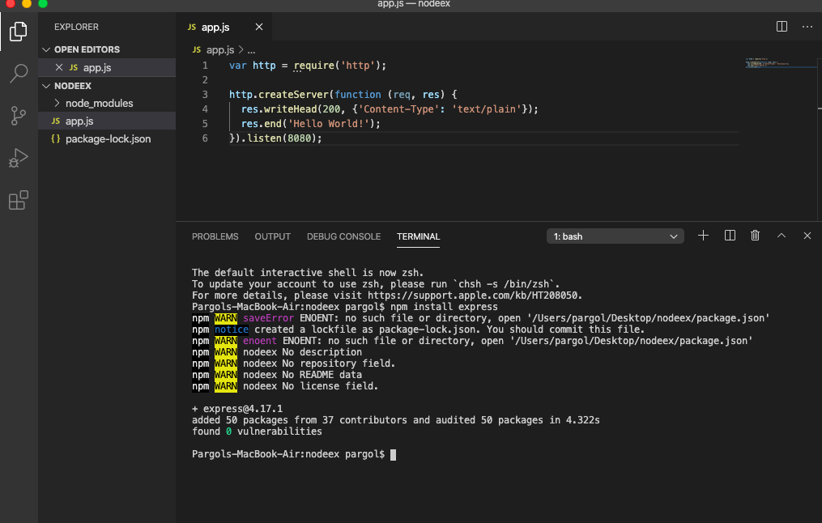
How to install in the code :

Slide 14
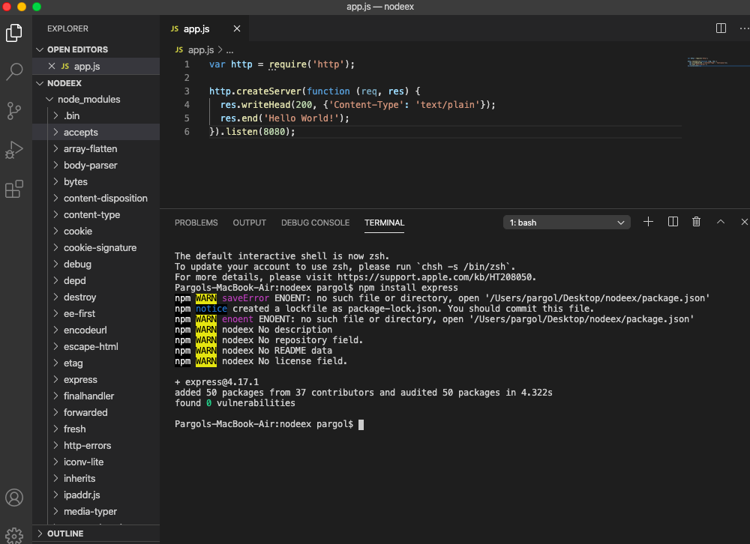
One module could depends on others , that’s why you have more than one

Slide 15
Node.js Modules
Consider modules to be the same as JavaScript libraries.
A set of functions you want to include in your application.
Include Modules:
To include a module, use the require() function with the name of the module:
var http = require('http');
Now your application has access to the HTTP module, and is able to create a server:
Previous slide

Slide 16
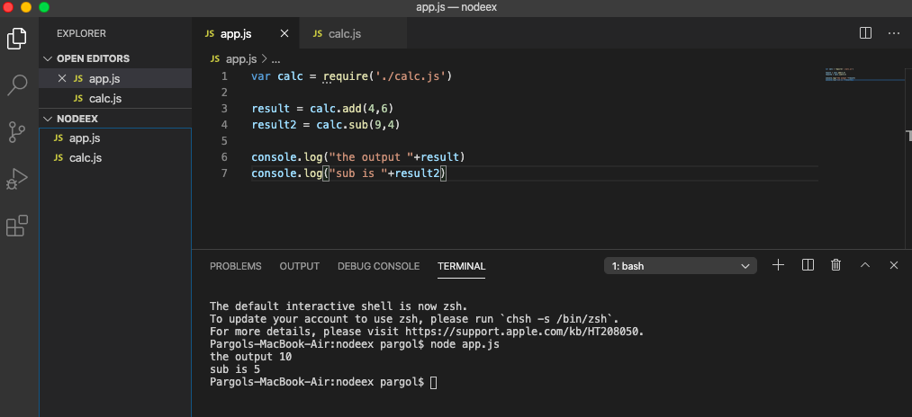
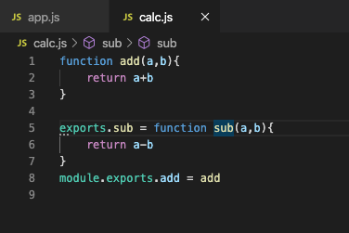
Different way to create Modules and exports them :

Slide 17
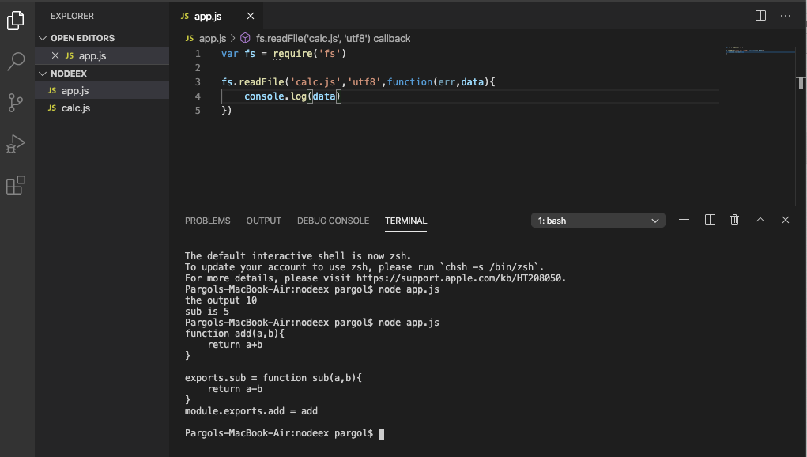
File System (fs) Module in Node JS
We should have an option to read or use the file in JS:

Slide 18
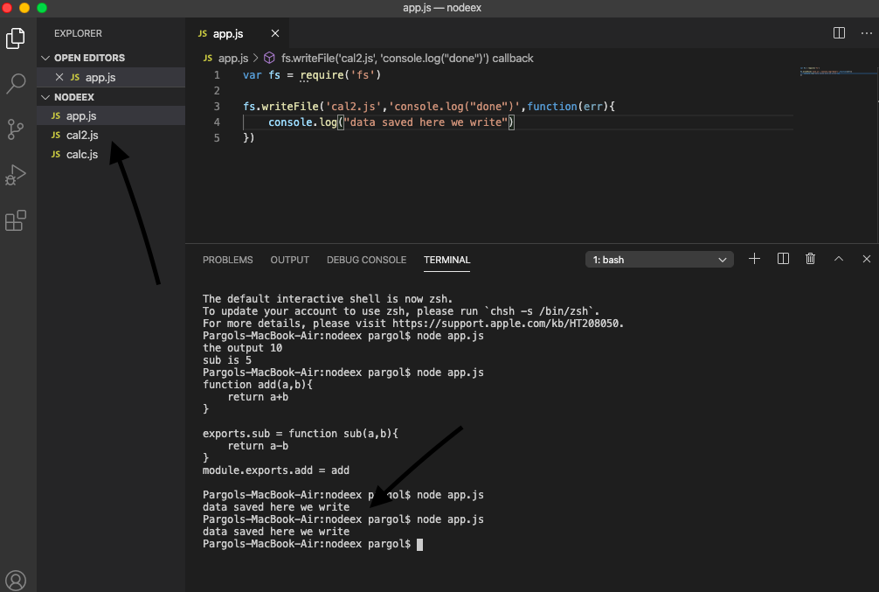
How about write the file?
If you write the name the file which is already exist ,it over write it.
To prevent that , instead of writeFile you can use appendFile

Slide 19
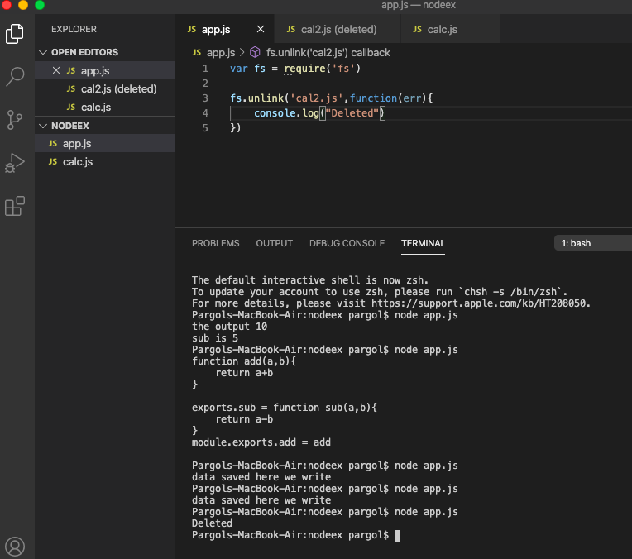
If you want to delet a file you need to use unlink function

Slide 20
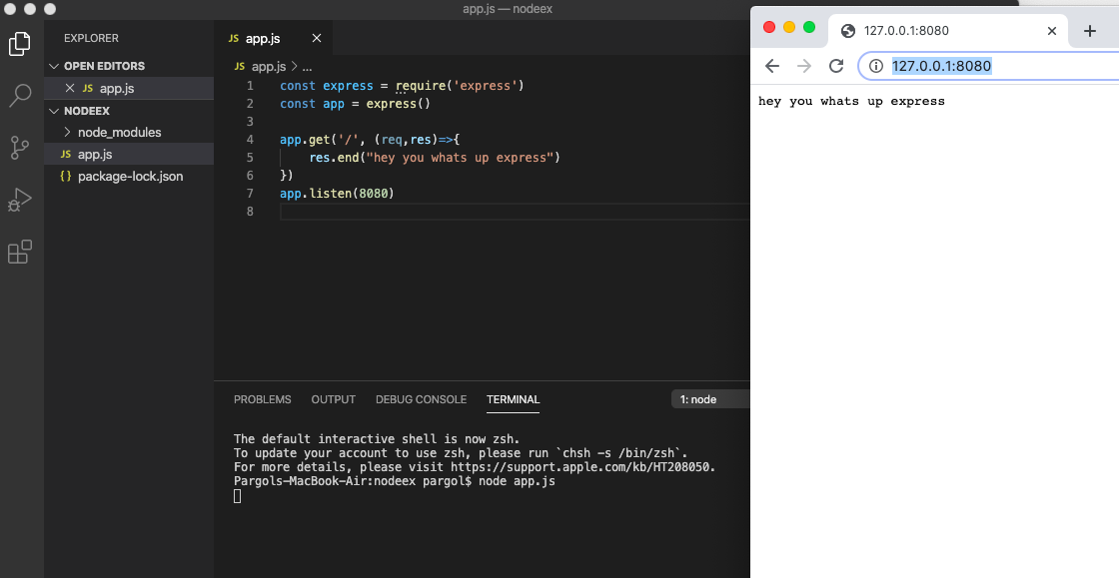
Use express module

Slide 21
Node.js MySQL
Node.js can be used in database applications. One of the most popular databases is MySQL.
MySQL Database
To be able to experiment with the code examples, you should have MySQL installed on your computer.You can download a free MySQL database at https://www.mysql.com/downloads/.

Slide 22
Install MySQL Driver
Once you have MySQL up and running on your computer, you can access it by using Node.js.
To access a MySQL database with Node.js, you need a MySQL driver. This tutorial will use the "mysql" module, downloaded from NPM.
To download and install the "mysql" module, open the Command Terminal and execute the following:

Slide 23
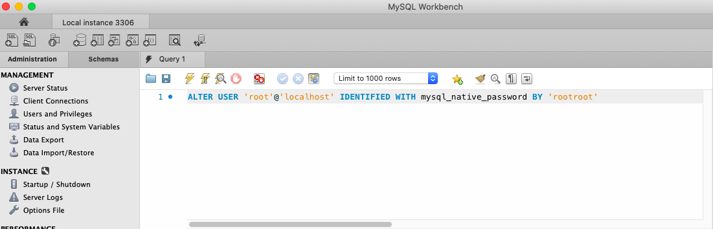
Now you have downloaded and installed a mysql database driver.
Node.js can use this module to manipulate the MySQL database:
Create Connection
Start by creating a connection to the database.
Use the username and password from your MySQL database.
Make sure you have workbench and mysql server download in your computer

Slide 24
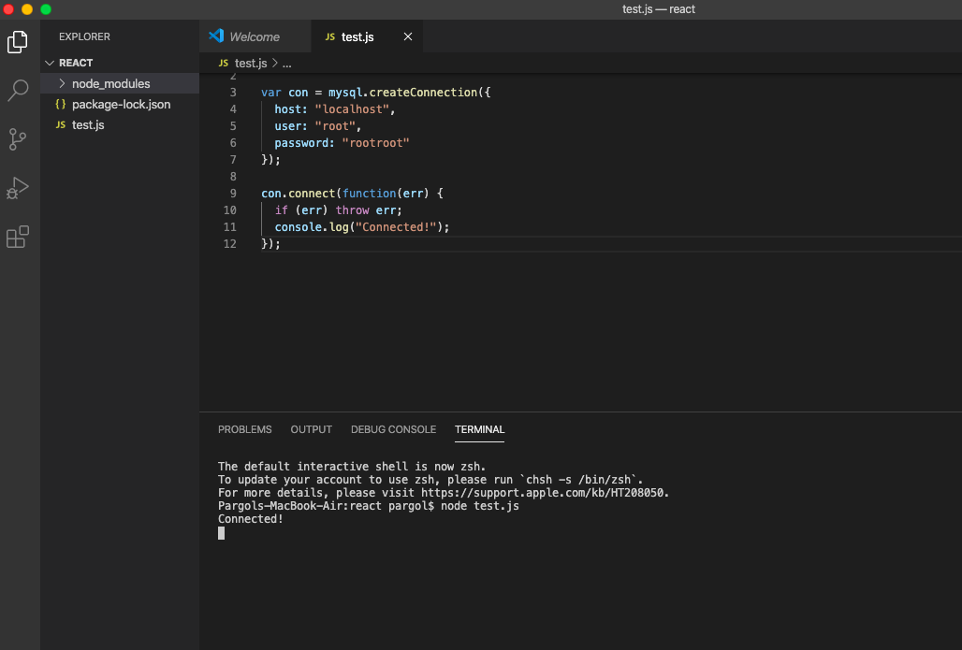

Slide 25
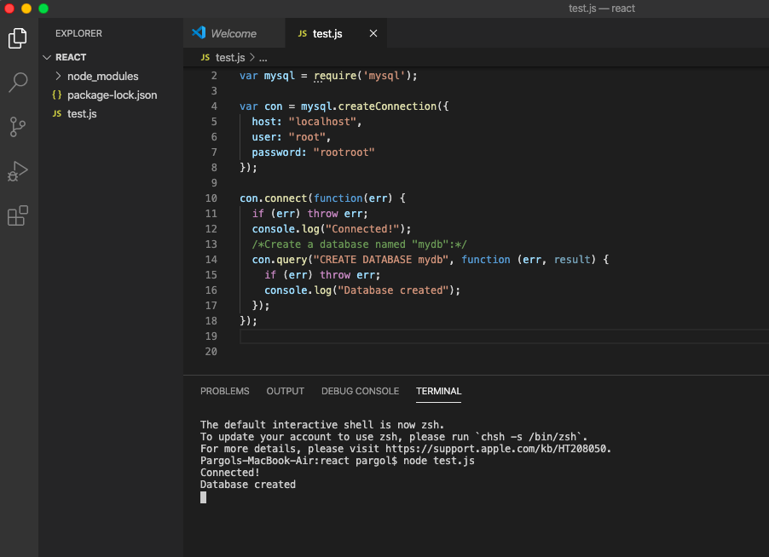
Creating a Database
To create a database in MySQL, use the "CREATE DATABASE" statement:

Slide 26
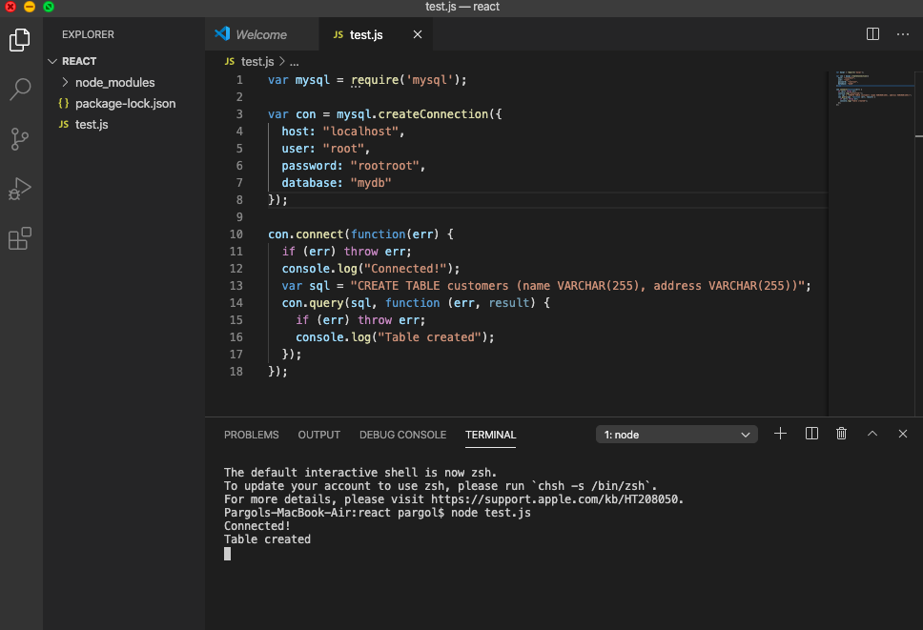
Creating a Table
To create a table in MySQL, use the "CREATE TABLE" statement.
Make sure you define the name of the database when you create the connection:

Slide 27
Primary Key
When creating a table, you should also create a column with a unique key for each record.This can be done by defining a column as "INT AUTO_INCREMENT PRIMARY KEY" which will insert a unique number for each record. Starting at 1, and increased by one for each record.
var sql = "CREATE TABLE customers (id INT AUTO_INCREMENT PRIMARY KEY, name VARCHAR(255), address VARCHAR(255))";
If the table already exists, use the ALTER TABLE keyword:
var sql = "ALTER TABLE customers ADD COLUMN id INT AUTO_INCREMENT PRIMARY KEY";

Slide 28
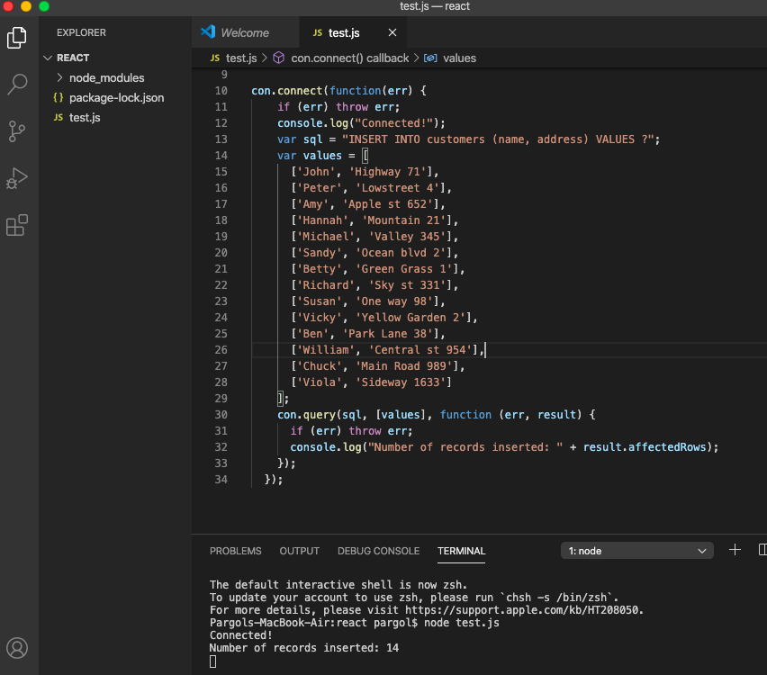
Insert Into Table
To fill a table in MySQL, use the "INSERT INTO" statement.

Slide 29
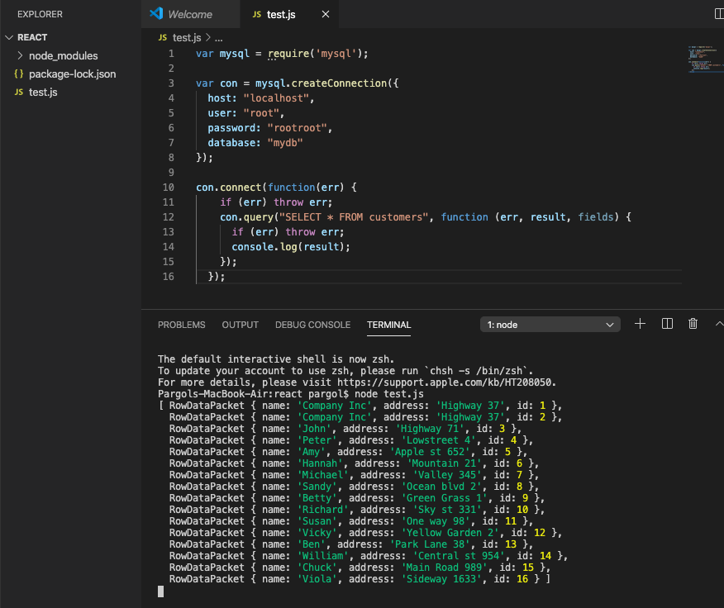
Selecting From a Table
To select data from a table in MySQL, use the "SELECT" statement.

Slide 30
Selecting Columns
To select only some of the columns in a table, use the "SELECT" statement followed by the column name.
con.connect(function(err) { if (err) throw err; con.query("SELECT name, address FROM customers", function (err, result, fields) { if (err) throw err; console.log(result); }); });

Slide 31
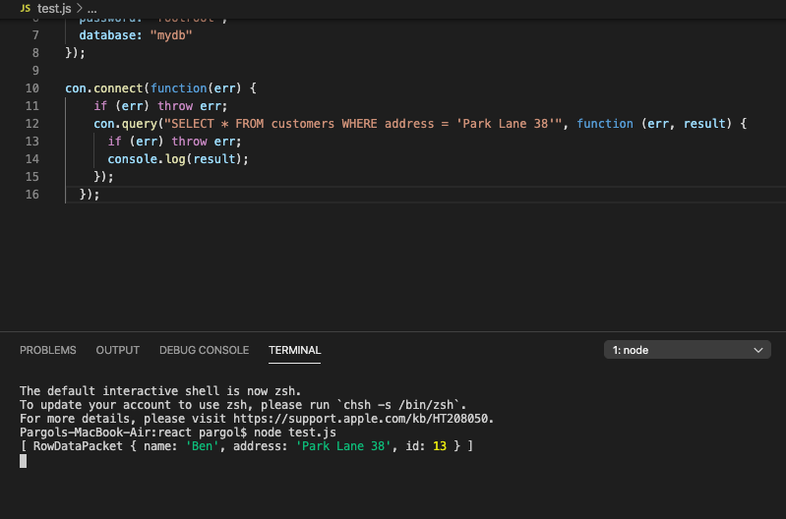
Node.js MySQL Where
Select With a Filter : When selecting records from a table, you can filter the selection by using the "WHERE" statement:

Slide 32
Delete Record
You can delete records from an existing table by using the "DELETE FROM" statement:
con.connect(function(err) { if (err) throw err; var sql = "DELETE FROM customers WHERE address = 'Mountain 21'"; con.query(sql, function (err, result) { if (err) throw err; console.log("Number of records deleted: " + result.affectedRows); }); });

Slide 33
Delete a Table
You can delete an existing table by using the "DROP TABLE" statement:
con.connect(function(err) { if (err) throw err; var sql = "DROP TABLE customers"; con.query(sql, function (err, result) { if (err) throw err; console.log("Table deleted"); }); });
Update Table
You can update existing records in a table by using the "UPDATE" statement:
con.connect(function(err) { if (err) throw err; var sql = "UPDATE customers SET address = 'Canyon 123' WHERE address = 'Valley 345'"; con.query(sql, function (err, result) { if (err) throw err; console.log(result.affectedRows + " record(s) updated"); }); });

Slide 34
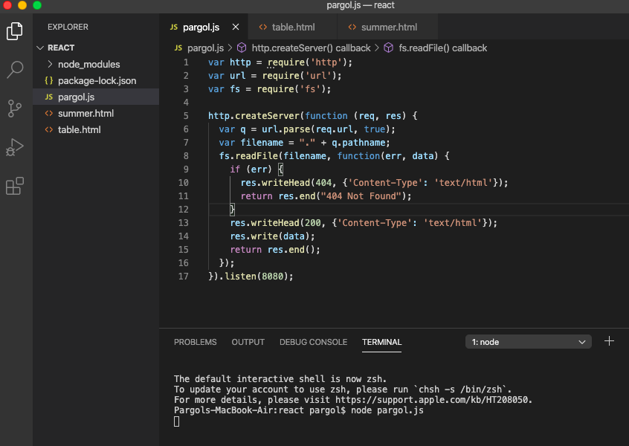
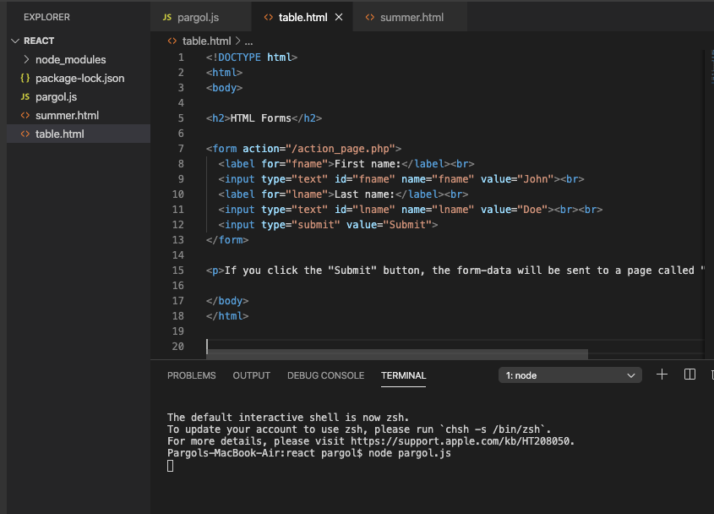

Slide 35
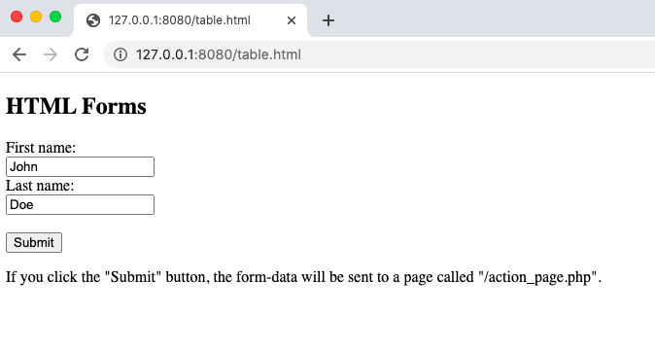

Slide 36
Exercise :
Create dynamic table

Slide 37
Finish

